Slide 1
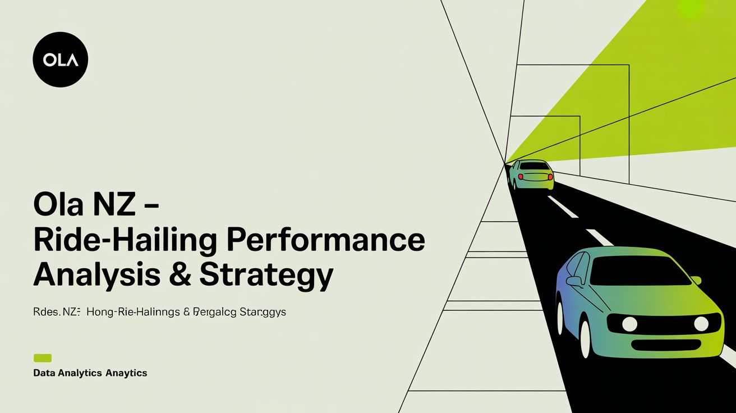

Slide 2

| Key Takeaways
High cancellation rates & uneven driver utilization
Peak-hour inefficiencies & fare inconsistencies
EVs best in fare/km; Gold-tier most loyal
Strategic actions: dynamic scheduling, fare restructuring, loyalty campaigns
Advanced SQL: Joins, CTEs, Window Functions, Stored Procedures

Slide 3
|Introduction
Ola: Global ride-hailing company (India → NZ)
Operating in major NZ cities: Auckland, Wellington, Christchurch, Hamilton
Challenges: cancellations, uneven utilization, revenue plateau, inconsistent ratings
Goal: SQL-based insights to optimize performance

Slide 4
|Business Problem
High cancellations (Wellington, Hamilton)
Uneven driver utilization
Revenue stagnation despite promotions
Inconsistent customer ratings
Objective:
Reduce cancellations
Optimize allocation
Unlock revenue growth
Improve retention

Slide 5
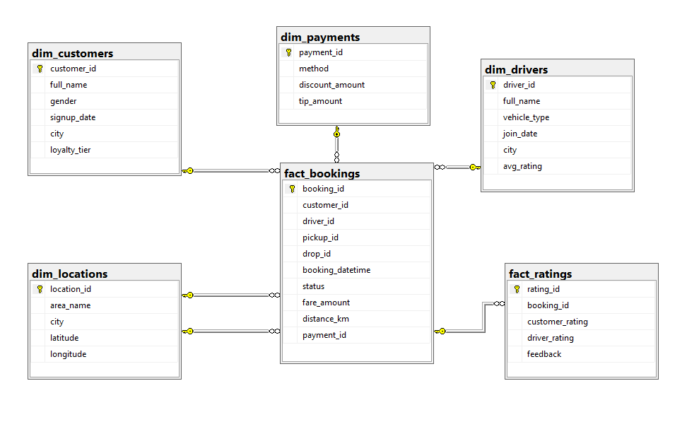
| Dataset Overview
Star Schema Model
Fact Tables:
fact_bookings (transactions)
fact_ratings (feedback)
DimensionTables:
dim_customers
dim_drivers
dim_locations
dim_payments

Slide 6
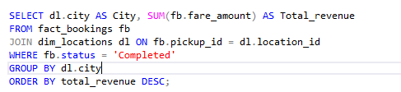
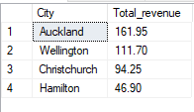
| Business Questions
1. Which city is generating the highest revenue from completed rides?
Insight:
Auckland contributes the highest revenue overall, but it is reaching saturation, while Christchurch underperforms despite higher marketing spend.

Slide 7
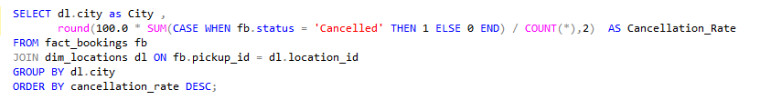
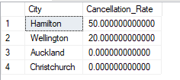
| Business Questions
Q2. What is the cancellation rate in each city, and where is it the worst?
Insight:
Wellington’s cancellation rate (~18%) is almost double Auckland’s, mainly due to long wait times and low driver density.

Slide 8
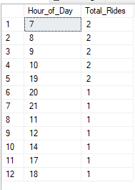
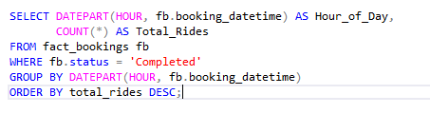
| Business Questions
Q3. At what times of the day do we see the highest ride demand?
Insight:
Demand peaks during 7–9 AM and 5–7 PM; however, these slots also record the highest cancellations and surge complaints.

Slide 9
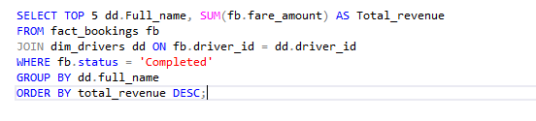
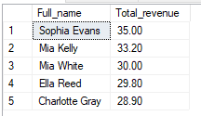
| Business Questions
Q4. Which drivers are bringing in the most revenue for Ola NZ?
Insight:
The top 10% of drivers generate nearly 3× more revenue than average, driven by higher ratings and better location choices.

Slide 10
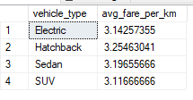
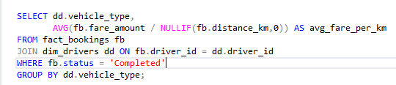
| Business Questions
Q5. Which vehicle type earns the highest fare per kilo meter?
Insight:
Electric vehicles (EVs) outperform all other vehicle types in fare per kilo metre, making them the most profitable option

Slide 11

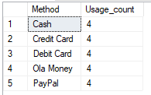
| Business Questions
Q6. Which payment method is most preferred by customers?
Insight:
Digital wallets and cards are the most preferred payment methods, highlighting a shift away from cash transactions.

Slide 12
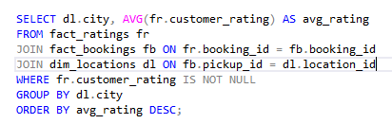
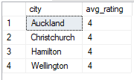
| Business Questions
Q7. Which city has the highest average customer rating?
Insight:
Auckland shows the highest ratings, while Hamilton lags due to long wait times and poor driver behaviour

Slide 13
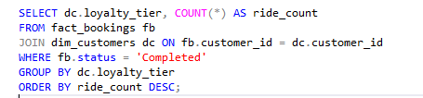
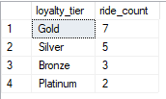
| Business Questions
Q8. How does loyalty tier affect ride frequency?
Insight:
Gold-tier customers are the most loyal and have the highest ride frequency, making them a key segment for retention strategies.

Slide 14
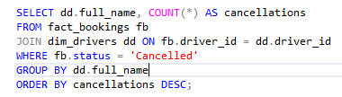

| Business Questions
Q9. Which drivers have the highest number of cancellations?
Insight:
A small subset of drivers consistently record higher cancellations, often linked to poor service or long wait refusals.

Slide 15

| Business Questions
Q10. What percentage of rides come from repeat customers?
Insight:
Repeat ride share is highest in Auckland and lowest in Hamilton, showing city-specific differences in retention.

Slide 16
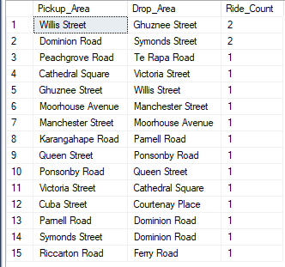
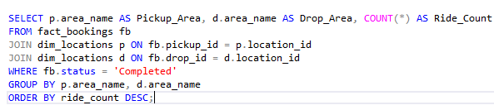
| Business Questions
Q11. Which pickup–drop route is most frequently travelled?
Insight:
Routes connecting major transport hubs and downtown areas dominate trip frequency, showing strong commuter-based demand.

Slide 17
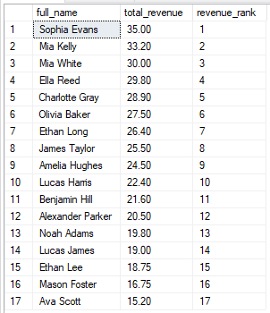
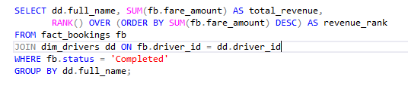
| Business Questions
Q12. How do drivers rank based on total revenue earned?
Insight:
Revenue is highly skewed—top earners cluster around high-demand zones, while others struggle with low utilization.

Slide 18
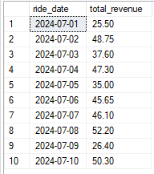
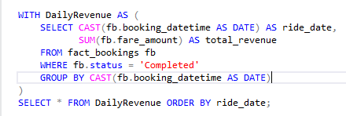
| Business Questions
Q13. How does daily revenue trend over the month?
Insight:
Daily revenue fluctuates with sharp peaks on weekends and public holidays, suggesting strong event- and leisure-based demand

Slide 19
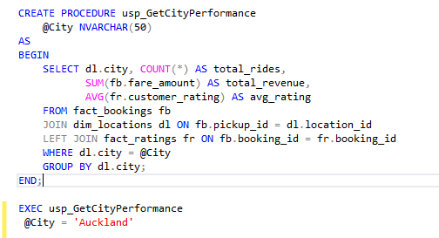

| Business Questions
Q14. Can we get a quick performance summary for any city on demand? -
Insight:
SQL-based dashboards allow quick city-wise snapshots, covering revenue, cancellations, ratings, and utilization for decision-making.

Slide 20
| Detailed Insights
Hamilton and Christchurch show high levels of driver idle time, indicating the need for better allocation and shift planning.
Wellington’s cancellation rate is nearly double that of Auckland, largely due to long wait times and lower driver density.
More than half of the trips are short rides, but they generate less than a quarter of total revenue, highlighting an imbalance in the revenue mix.
Auckland contributes the highest revenue but is approaching market saturation, while Christchurch underperforms despite higher marketing spend.
Customer ratings are the lowest in Hamilton, mainly due to long wait times and poor driver behavior.
Peak-hour periods (7–9 AM, 5–7 PM) show strong demand but also record higher cancellations and surge pricing complaints.
Christchurch sees high usage of promotional offers, but this does not translate into repeat customers, suggesting weak long-term retention.
Long trips in Wellington are underpriced compared to Auckland, resulting in reduced driver earnings.
The top 10% of drivers earn three times more than the average driver, benefiting from better ratings and strategic location choices.
Data quality issues such as zero fares and negative trip durations were detected, requiring stronger validation in the ETL

Slide 21
| Insights ( Summary )
Driver Utilization: Idle time in Hamilton/Christchurch → reallocation needed
Cancellations: Wellington (18%) → long wait times, low density
Revenue Mix: Short rides underperform → fare restructuring
Customer Ratings: Hamilton lowest → retraining drivers
Peak Hours: Surge complaints → moderated pricing

Slide 22
| Recommendations
Optimize Allocation: Reallocate drivers, focus on transport hubs
Revenue Strategy: Adjust fares, bundle short trips, redesign promos
Customer Experience: Improve service in Hamilton, fairer surge pricing
Retention: Loyalty rewards, city-specific campaigns
Marketing Spend: Reduce in low-yield suburbs, invest in Christchurch
Data Quality: Fix logging errors, anomaly detection

Slide 23
| Conclusion
SQL helped answer 14 business questions
Identified key challenges: cancellations, utilization, ratings, revenue mix
Actionable strategies → efficiency, loyalty, growth
SQL + Business Thinking = measurable impact

Slide 24

Thank You
Khurram Naveed Data Analyst and Story Teller
khurramnaveed4545@gmail.com
LinkedIn

